Slide 1

ECE201R01 : Microprocessor & Microcontroller
Unit I: 8086 - Timing Diagram
Timing Diagram

Slide 2
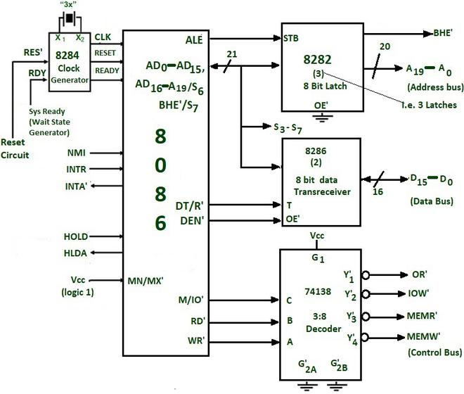

Slide 3
T-State & Machine Cycle
T-State:
One T-state or state is referred to as one clock cycle of system clock.
It is also a part of operation performed by the CPU in one clock cycle.
Machine cycle (MC):
The necessary steps carried out to perform a fetch, read or
write operation to constitute a machine cycle.
A MC consists of several T-states.
Timing Diagram

Slide 4
Instruction Cycle
An instruction is a command given to the computer to perform a specified operation on the given data.
Program is a sequence of instructions to perform a task.
Program & data are stored in memory.
The CPU fetches one instruction at a time from memory & executes it.
The necessary steps that a CPU carries out to fetch an instruction and necessary data from memory, and to execute it constitute an instruction cycle.
An instruction cycle consists of a Fetch & Execute cycle.
IC = FC + EC. An IC consists of several MC
Timing Diagram

Slide 5
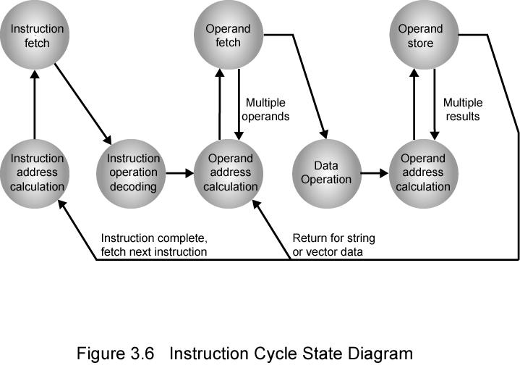
Instruction Cycle State Diagram
Timing Diagram

Slide 6
Instruction Cycle
Instruction Fetch (IF): Read instruction from its memory location into the processor.
Instruction Operation Decoding (IOD): Analyze instruction to determine type of operation to be performed and operand(s) to be used.
Operand Address Calculation (OAC): If the operation involves reference to an operand in memory or available via I/O, then determine the address of the operand.
Operand Fetch (OF): Fetch the operand from memory or read it in from I/O.
Data Operation (DO): Perform the operation indicated in the instruction.
Operand Store (OS): Write the result into memory or out to I/O.
Timing Diagram

Slide 7
Timing Diagram
Timing diagram is the pictorial representation on the change in state of various signals depicted in vertical axis with respect to the time in horizontal axis
It also helps us to understand the sequential interactions and constrains between state of various signals in accomplishing a specific task
In 8086, Timing diagram shows the status of various control & status signals w.r.t. time to complete a Machine Cycle
Timing Diagram

Slide 8
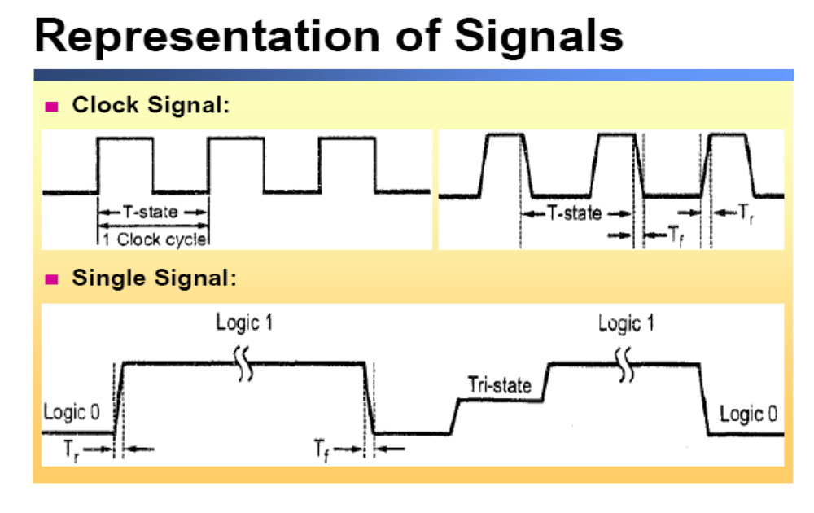
Timing Diagram

Slide 9
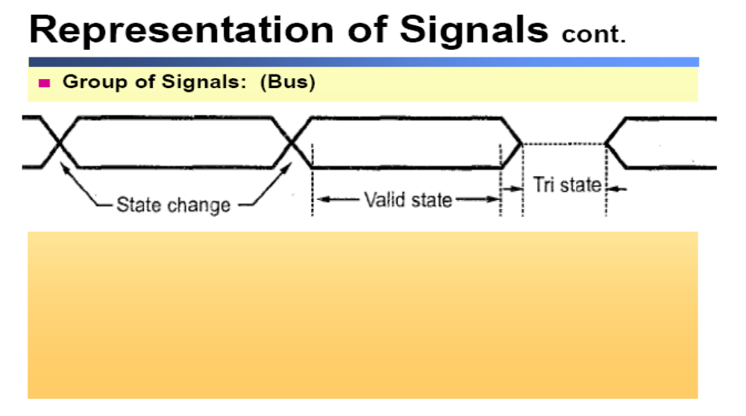
Timing Diagram

Slide 10
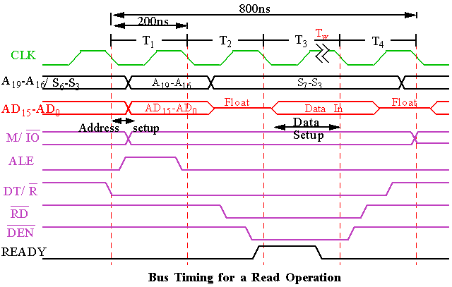
Memory Read MC in Minimum mode
Timing Diagram

Slide 11
During T ₁ : The address is placed on the Address/Data bus. Control signals M/ IO , ALE and DT/ R specify memory or I/O, latch the address onto the address bus and set the direction of data transfer on data bus.
During T ₂ : 8086 issues the RD or WR signal, DEN , and, for a write, the data.
  DEN enables the memory or I/O device to receive the data for writes and the 8086 to receive the data for reads.
Timing Diagram

Slide 12
During T ₃ : This cycle is provided to allow memory to access data. READY is sampled at the end of T 3 .
  If low a wait state is inserted after T ₃.
  Otherwise, the data bus is sampled at the end of T ₃ .
During T ₄ : All bus signals are deactivated, in preparation for next bus cycle. Data is sampled for reads, writes occur for writes.
Timing Diagram

Slide 13
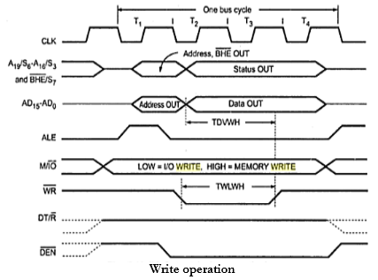
Memory Write MC in Minimum mode
Timing Diagram

Slide 14
Thank you . . .
Timing Diagram

